Slide 1


TravelBird.com
Team 4
Archana Kishore, Briana Arnold, Tanaya Nandanwar
CIS 9490

Slide 2





Usability Test Analysis
PRICELINE.COM

Slide 3


Summary
Conducted on Priceline.com on November 20, 2017
Users (Ages 25 – 35)
6 users 3 users
Objectives
Filter feature when searching for flights
Overall flight search experience

Slide 4
Preliminary Results
Use both mobile and desktop apps, but prefer booking on desktop
Frustrated with fluctuating flight costs
Members of Loyalty Programs (Kayak, Expedia, Orbitz, etc.)

Slide 5
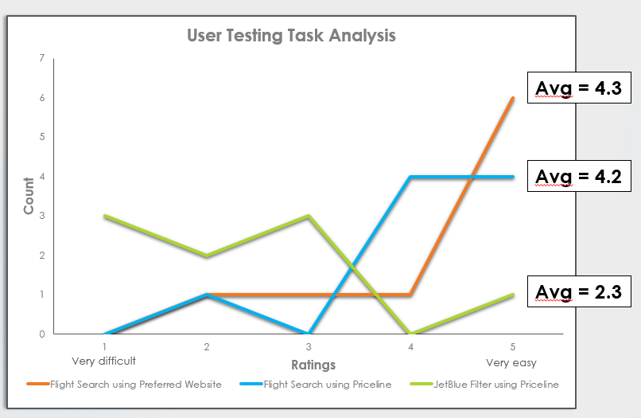
Subjective Ratings

Slide 6
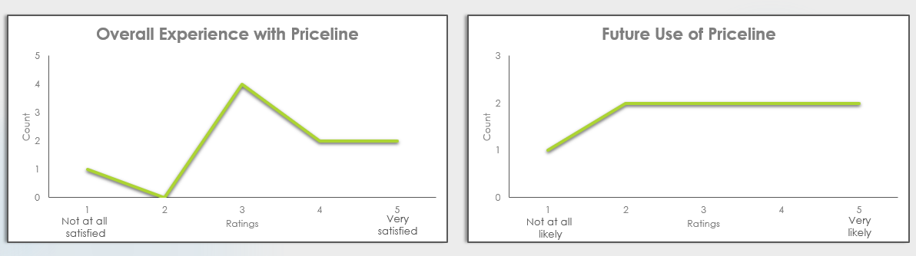
Subjective Ratings
Avg = 3.4
Avg = 3.2
Users were satisfied with Priceline’s clean, simple, and easily navigable design.

Slide 7

Problem Areas
Automatically defaults to Hotels
Constant reloading after filtering
Lack of Price Graphs/Calendar
Unable to filter “Basic Economy” flights

Slide 8
User Testing Video Links
Briana Arnold
https://www.usertesting.com/v/86c26966-b94e-4e40-bf45-5ae2e8a3ae62?encrypted_video_handle=RjhuwL0CTCwG1b0ukugR5Q#!/notes
https://www.usertesting.com/v/9acc2060-741f-4d11-b50a-e6511b994621?encrypted_video_handle=_Rj42Znd_L7GlzBcYt5Xfg#!/notes
https://www.usertesting.com/v/a56785a0-6b47-48ff-8071-1cec8f31204d?encrypted_video_handle=c31zKN9T9irMPT5AvhPmSA#!/notes
Archana Kishore
https://www.usertesting.com/v/f70e4614-fd50-4002-8bff-fc138582cacd?encrypted_video_handle=Kh3xoxCJwD2GXBIzI_cDQg#!/notes
https://www.usertesting.com/v/9dbf76ea-fe0d-463f-8827-fe367f660b12?encrypted_video_handle=LJQ05qQA8_ktvK06fUOufg#!/notes
https://www.usertesting.com/v/06d12b55-daf3-4ddc-bc02-d9507b5428ee?encrypted_video_handle=WdhkluhaAxUkkcM6kO229g#!/notes
Tanaya Nandanwar
https://www.usertesting.com/v/f0420cd7-cfa1-4816-834c-828ac411f86c?encrypted_video_handle=GMWJqPGz1ULlc0PhyeZm4g#!/notes
https://www.usertesting.com/v/bdf59956-eedf-43bc-8cff-a7ae527a94d5?encrypted_video_handle=e_ruGZ7iRNnnm49XbS3fDw#!/notes
https://www.usertesting.com/v/3bbcbfd4-8662-459e-bcb8-fba8c797589d?encrypted_video_handle=eg7-W9nuyi-uqyVdkxhu5Q#!/notes

Slide 9
Competitive Analysis
PRICELINE VS ONETRAVEL VS CHEAPOAIR

Slide 10
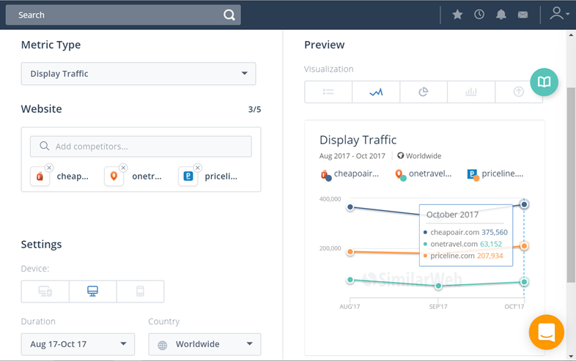
Websites Traffic Comparison
cheapOair has the highest number of users visiting their site when compared against Priceline and OneTravel.
(Source: www.similarweb.com)

Slide 11
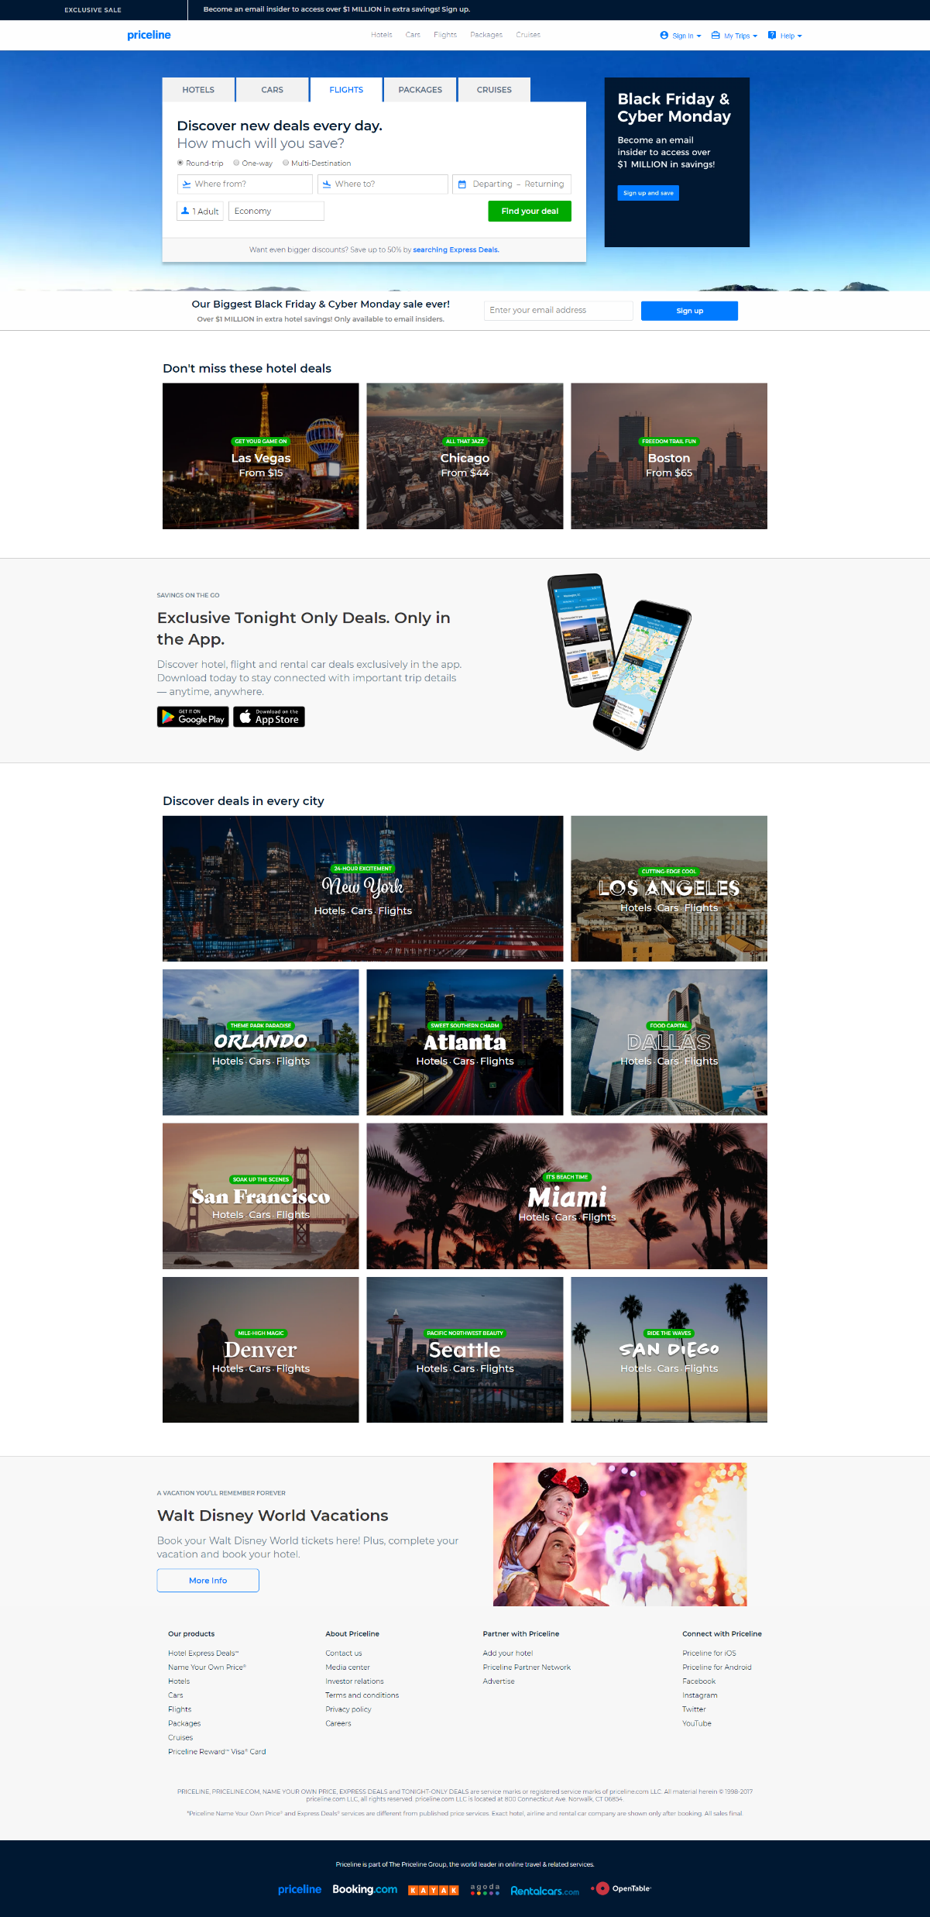

Priceline vs OneTravel
Home Page
Priceline and OneTravel offer booking services for vacation packages, including flights, hotels, cruises, and cars.
Both display prices for popular destinations
Both offer seasonal discounts (ex: Black Friday deals)
OneTravel displays car deals and advertises the company’s credit card
Priceline’s design is more clean and appealing

Slide 12
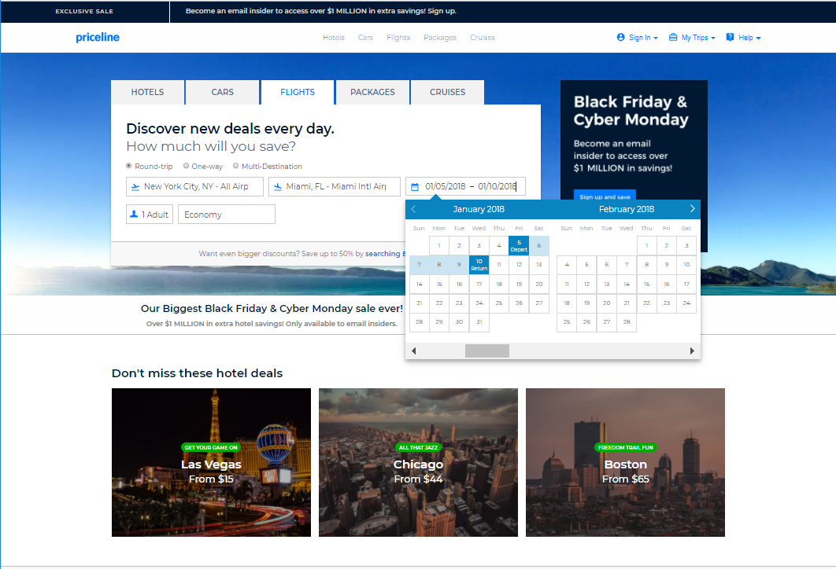
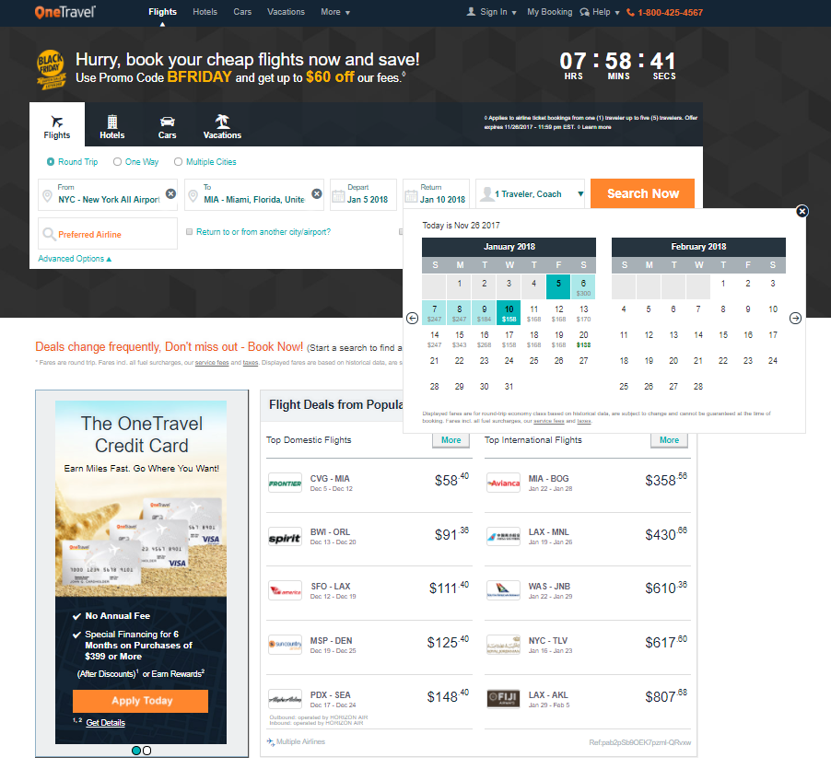
Priceline vs OneTravel
Search
The Search feature is on the home page and allows users to search for flights, hotels, cars, and vacation packages.
OneTravel automatically populates the departure field based on the user’s location
OneTravel’s Search feature offers Advanced Options (Preferred Airline, Return to Another City, Direct Flights Only)
OneTravel’s Calendar feature displays the lowest price on each date

Slide 13
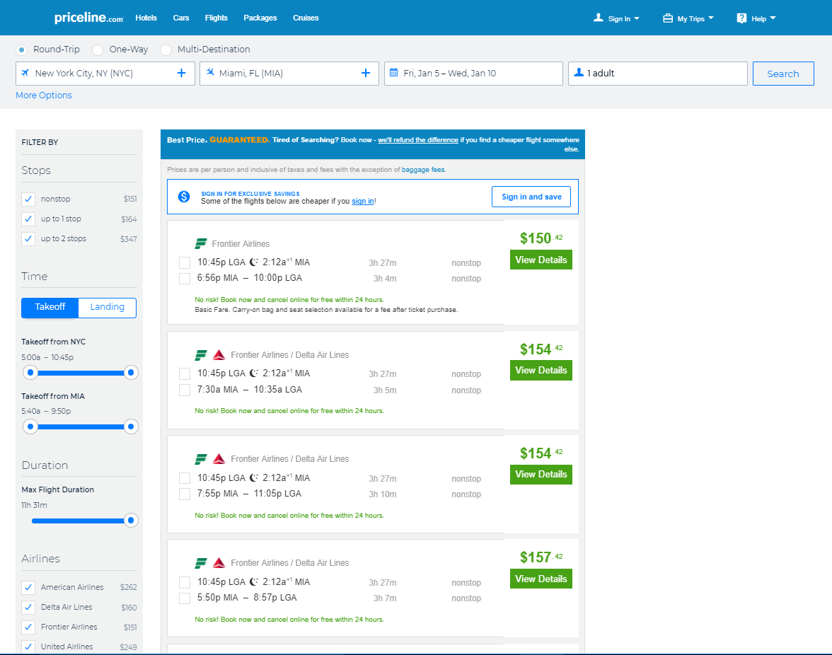
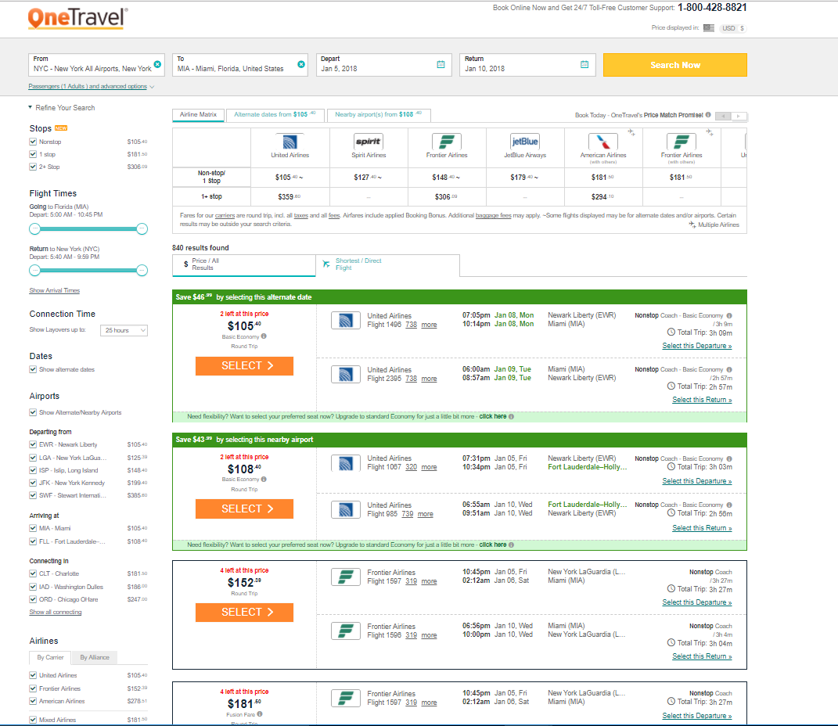
Priceline vs OneTravel
Search Results
The search results display flights related to the user’s search and filters that can be used to narrow the results
Both allows the user to filter by number of stops, flight time and duration, and specific airlines
OneTravel displays prices based on each airline
OneTravel provides alternate dates with cheaper options
OneTravel provides nearby airport options
OneTravel allows user to filter preferred connecting airports
Priceline’s design is clean and more readable

Slide 14
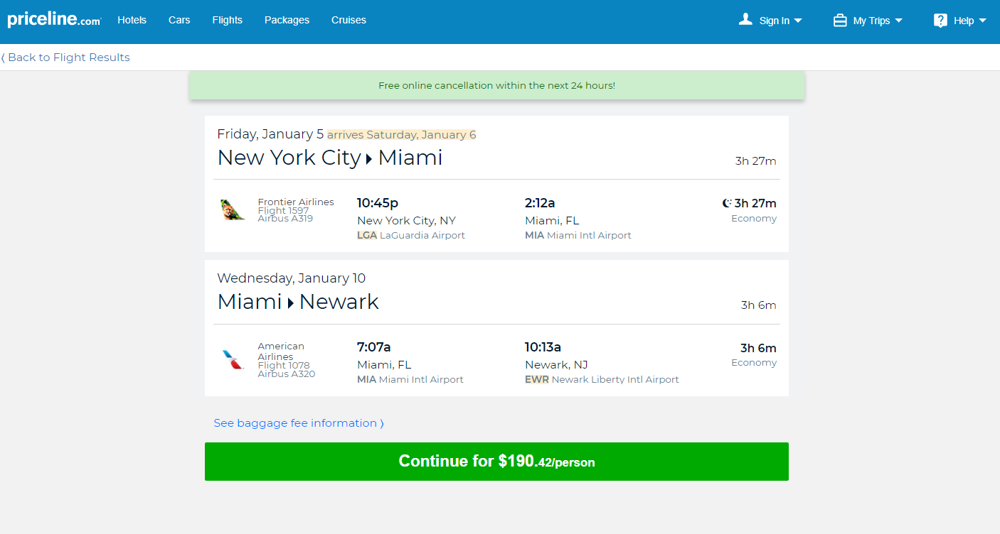
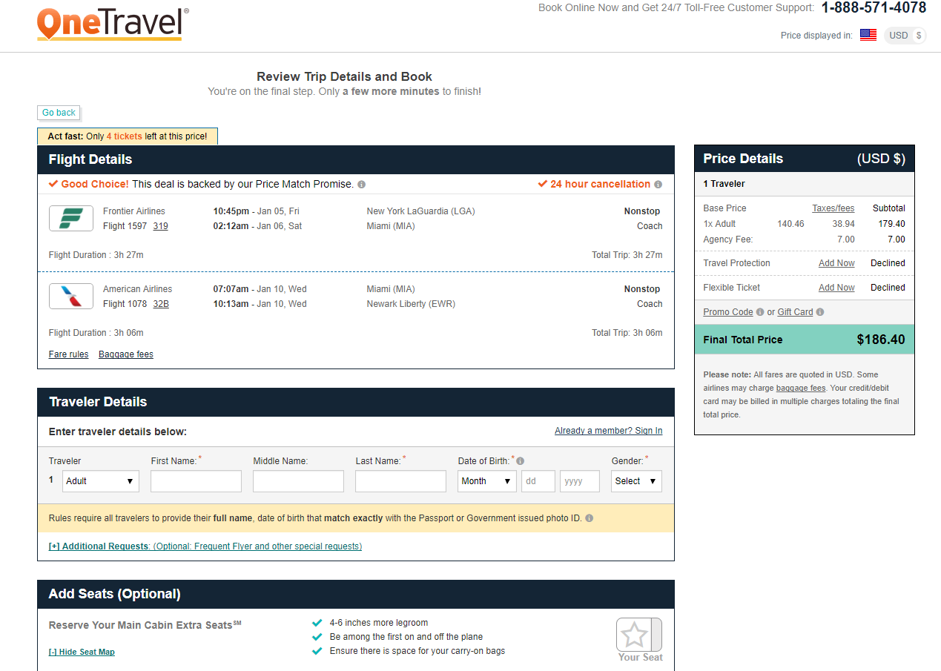
Priceline vs OneTravel
Booking Flight
The booking page displays flight details.
OneTravel shows all information and offers on one continuous page
Priceline’s booking process involves multiple pages.
OneTravel offers a lower price despite there being no difference in flight details

Slide 15
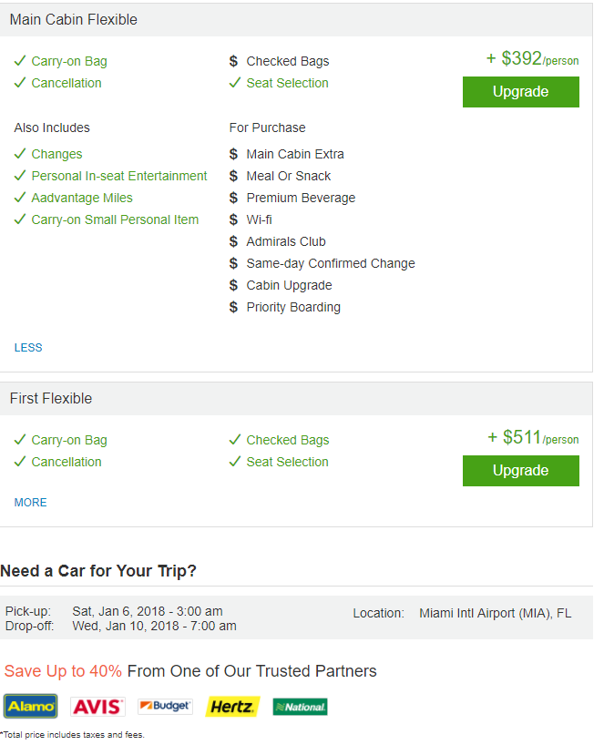
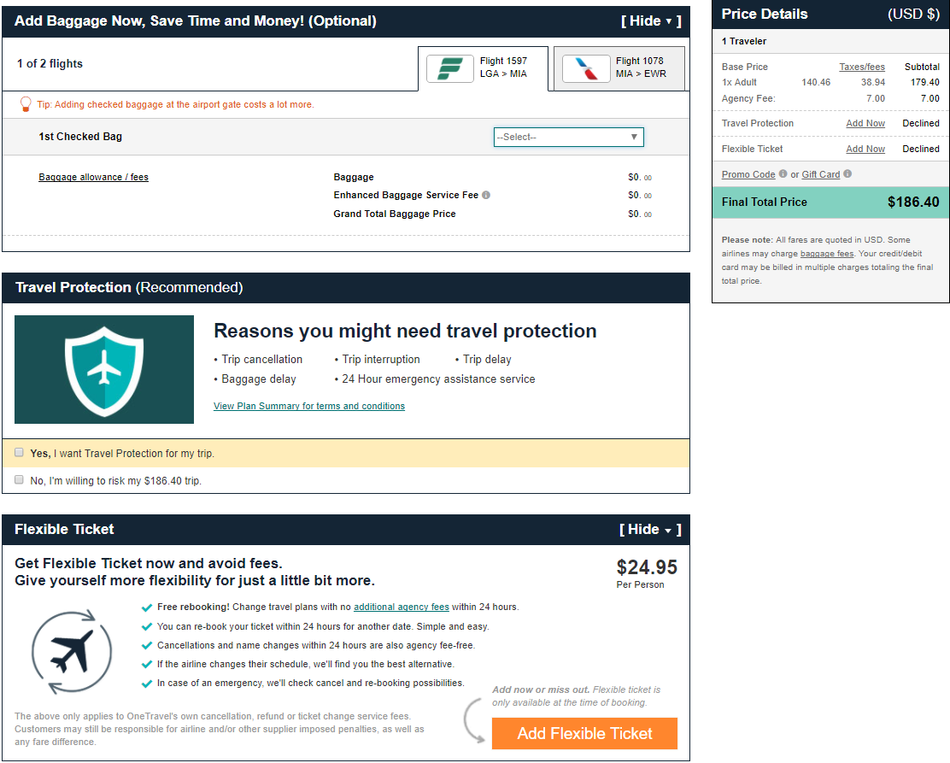
Priceline vs OneTravel
Booking Flight ctd..
The booking page displays flight details.
OneTravel allows users to pay immediately for luggage
OneTravel allows user to select seats and add travel insurance.
OneTravel offers “Flexible Ticket” so that users can change travel dates within 24 hours
Priceline allows users to upgrade and displays the perks of each option
Priceline offers car rental options.

Slide 16
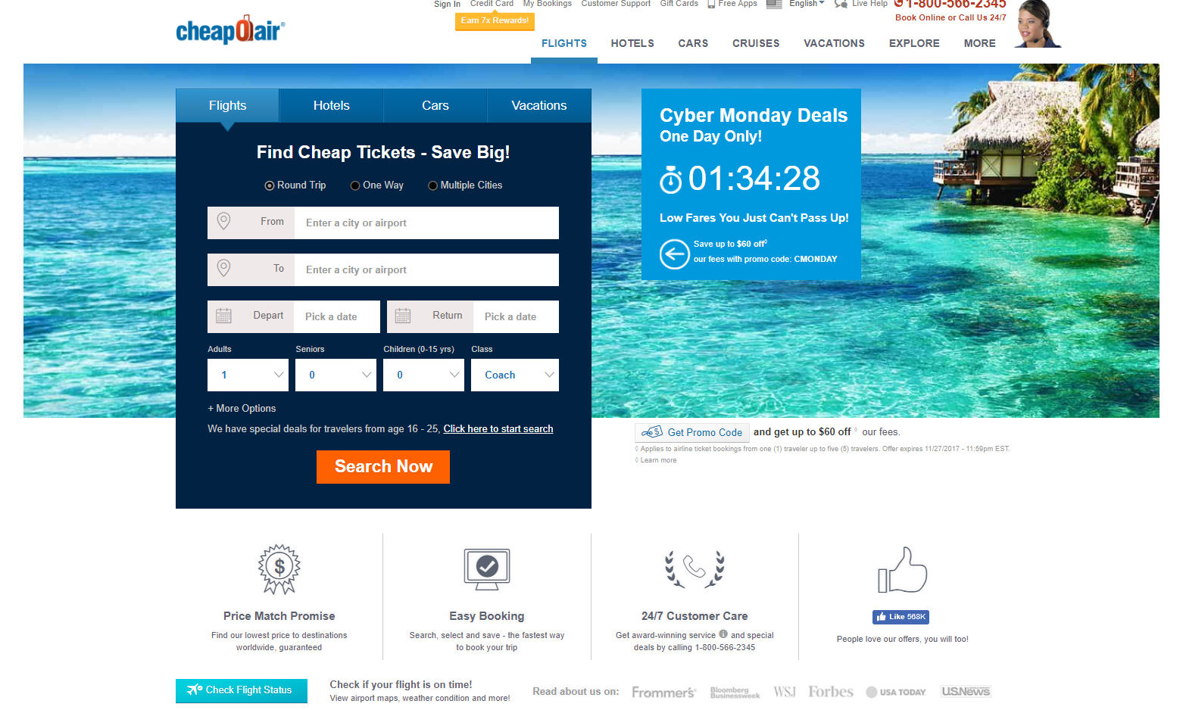
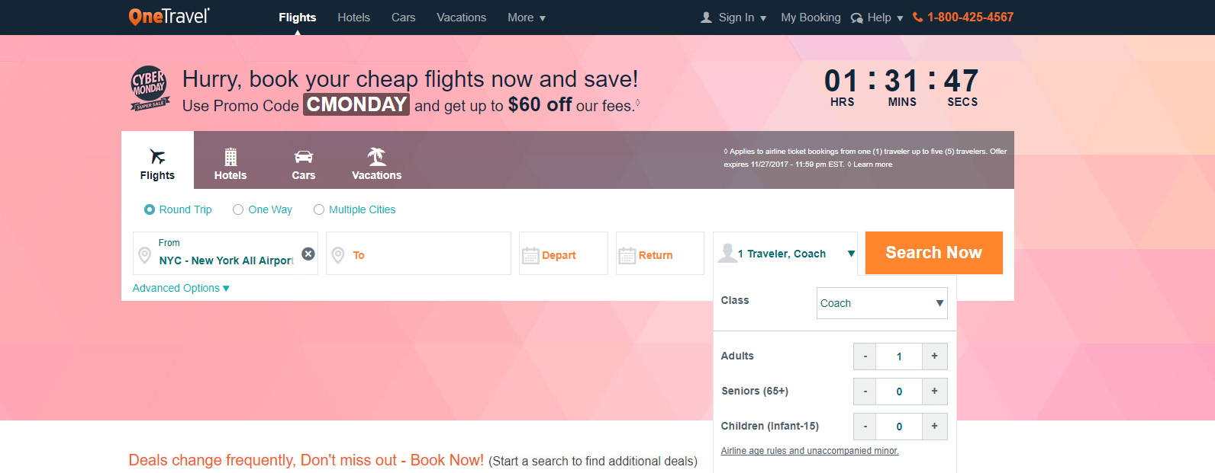
cheapOair vs OneTravel
Home Page
The home page of cheapOair and OneTravel enables users to select flights, hotels, cars, cruises and other vacation packages. Both the websites have similar features, but there are some notable differences in the user experience provided by both :
OneTravel’s navigation is simple and easier to understand. The placement of the menu items is much more structured than that of Cheapaair
cheapOair enlists all its services right on the top of the page, which makes it convenient for the user to choose any of those quickly
cheapOair has a Gift Card option that cannot be found on OneTravel
cheapOAir has a special offer for people aged 16-25.
cheapOair has separate sections for Traveler’s Age and Class, which is more user friendly
cheapOair also has Check Flight Status feature which OneTravel does not

Slide 17
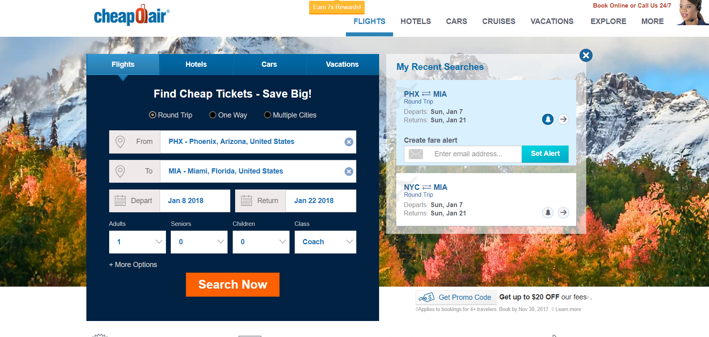
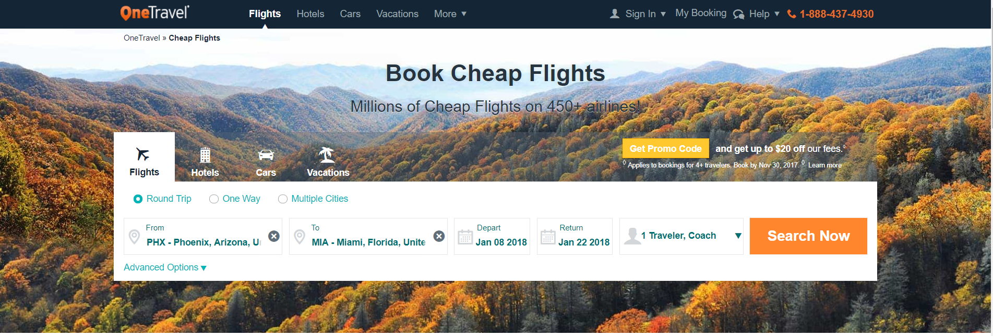
cheapOair vs OneTravel
Home Page ctd..
cheapOair has a very impressive feature “My Recent Searches”, which marks all the recent searches of each user and once the user logs in, it displays all the searches performed in reverse chronological order.
My Recent Searches provides user with two options:
Allows user to create fare alert which will be sent periodically to the email id of user’s choice.
Allows the user to go ahead and perform search for the same criteria again.
This is a unique feature for cheapOair, as OneTravel only auto fills the flight search form with the values of the latest search performed by the user. Rest of the searches are not shown.

Slide 18

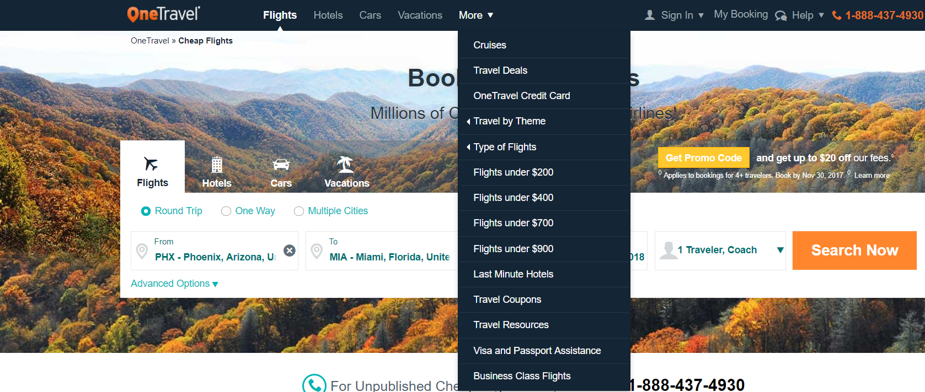
cheapOair vs OneTravel
Home Page ctd..
The More dropdown menu is available on both cheapOair and OneTravel. But cheapOair has a more categorized version, in which each subsection has a specific type of deal or caters to a specific section of people.
This is more effective and eases search for user, as he/she would not have to go through the entire list of options under More section like in that of OneTravel website, which is unstructured and confusing.

Slide 19
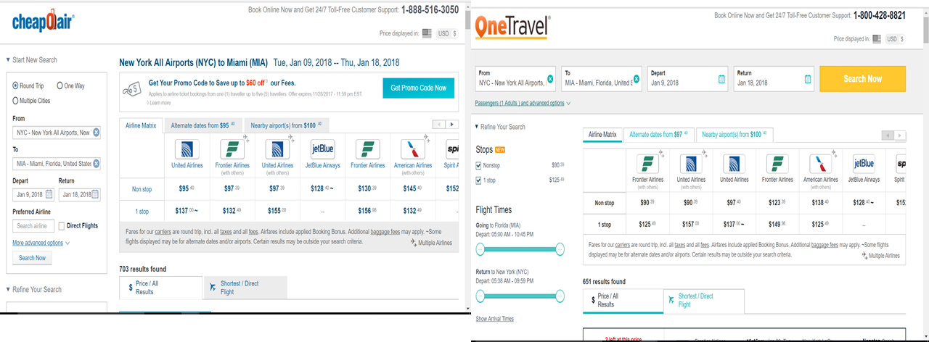
cheapOair vs OneTravel
Search Results
After the users have entered the departure and arrival cities including the travel dates, the system displays the search results.
For cheapOair, there are upfront options to change the trip to one way, round trip or multiple flights. On OneTravel, the user has to select the “Passenger and advanced options” to change the trip to one way, return or multiple flights. This is tedious and difficult to find and the users might end up going to the home page and re-entering the details.

Slide 20
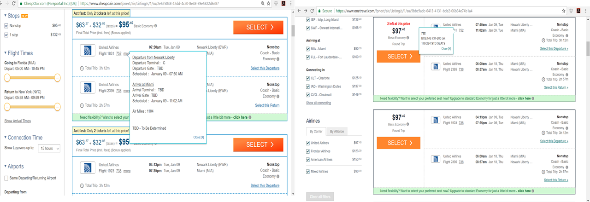
cheapOair vs OneTravel
Search Results
On the search results page, cheapOair has a special feature which displays the departure/arrival terminal and gate details besides the flight number. This is a very useful option for the user. OneTravel doesn’t include any such feature.

Slide 21
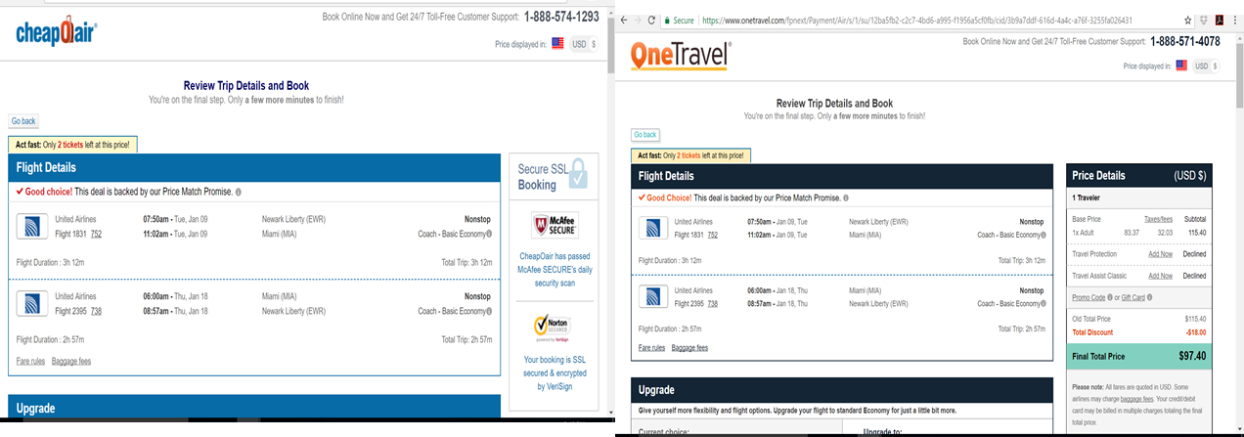
cheapOair vs OneTravel
Booking Flight
Once the flights are selected, the booking page is displayed.
OneTravel shows the fare summary on the right side of the pane that remains frozen as the users scroll through the page. cheapOair doesn’t have this feature.
The users can also add travel protection through this fare summary instead of scrolling down the entire page. The Final Total Price reflects immediately.

Slide 22
Diagrams

Slide 23
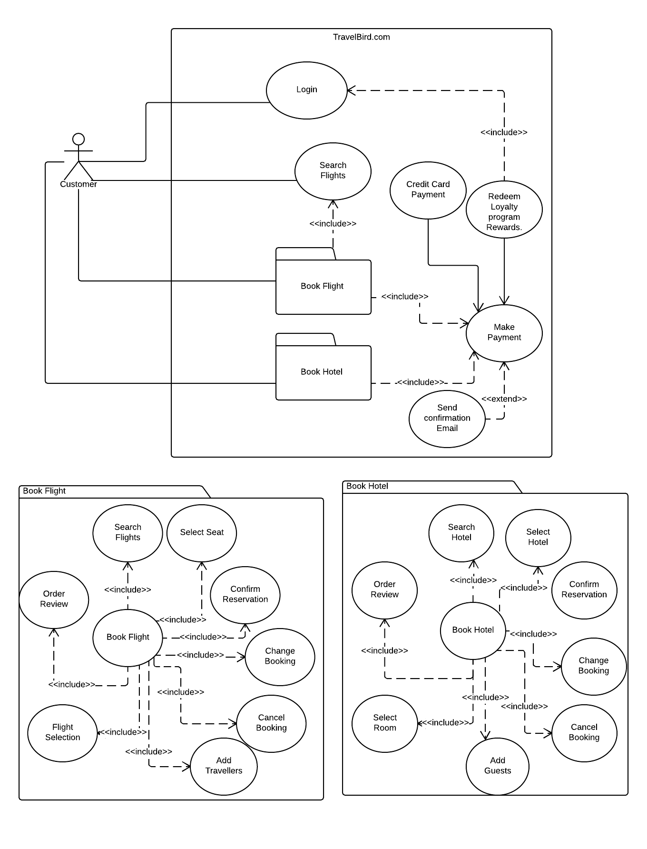
Use Case Diagram

Slide 24
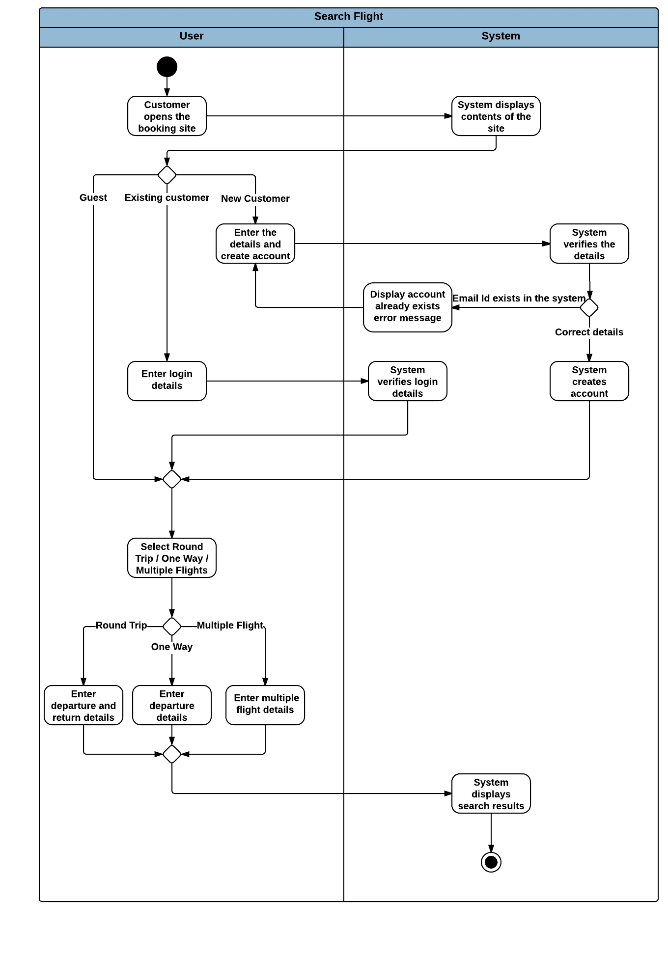
Activity Diagram: Search Flight

Slide 25
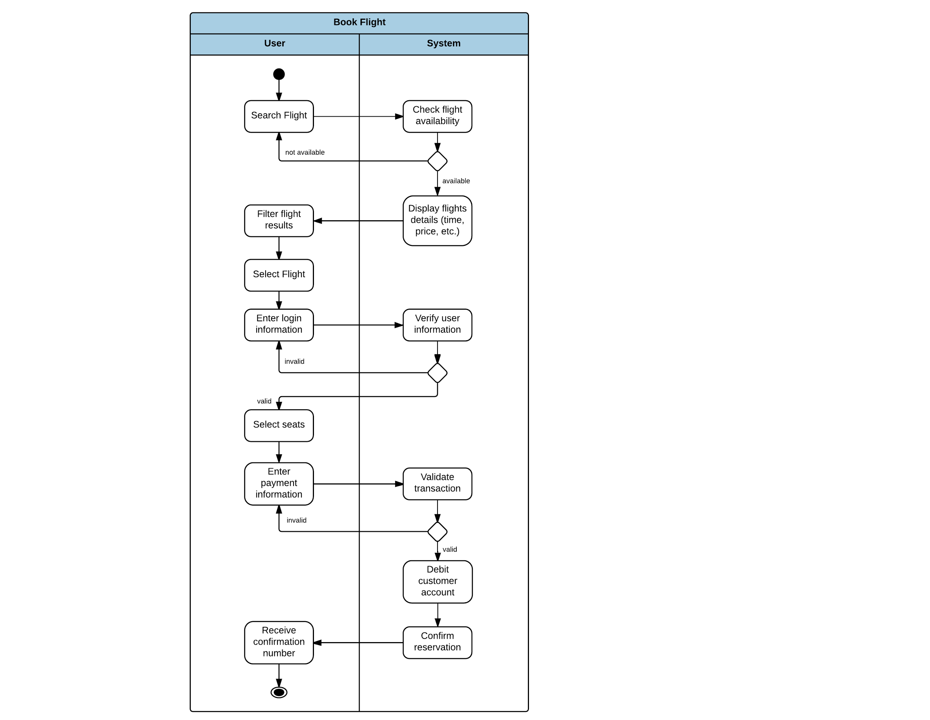
Activity Diagram: Book Flight

Slide 26
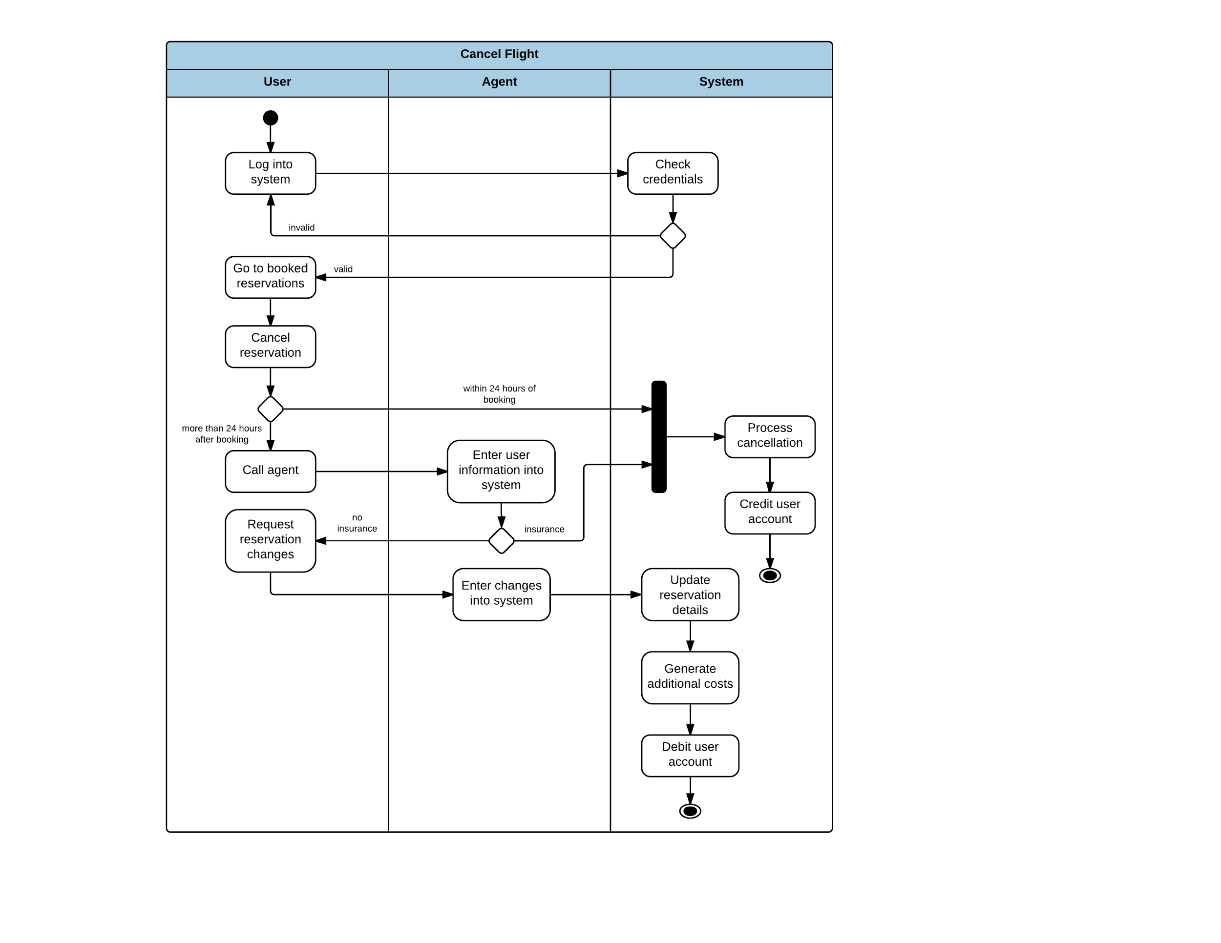
Activity Diagram: Cancel Flight

Slide 27
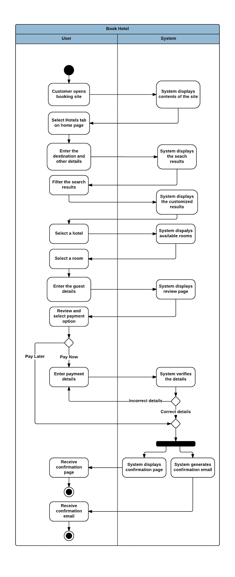
Activity Diagram: Book Hotel

Slide 28
Wireframes

Slide 29
Wireframe Links
https://drive.google.com/open?id=16eWvV355bKWNI1SZXwfdZjeNCv8802z2

Slide 30
Safe Travels

